Slide 1

Hyperparameter Tuning in Supervised ML
Today’s Agenda
What are hyperparameters?
Why tuning is important?
Popular techniques: Grid Search, Random Search
Using GridSearchCV from scikit-learn
Hands-On Practice
Kahoot(Quiz)

Slide 2
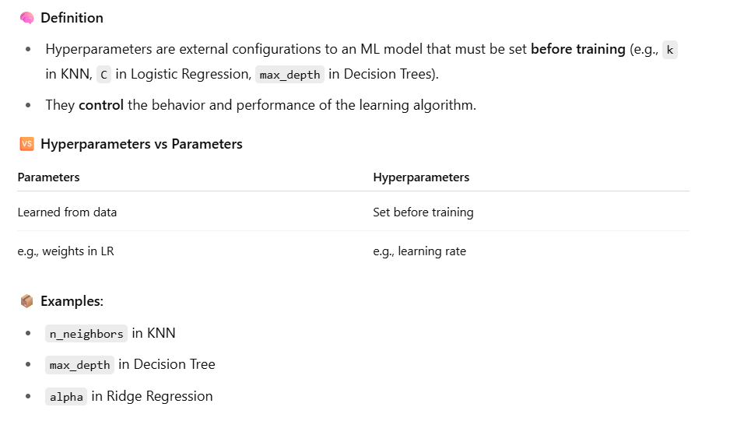
What are Hyperparameters?

Slide 3
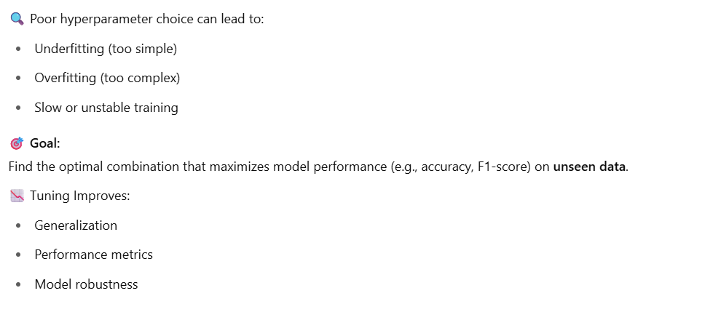
Why Tune Hyperparameters?

Slide 4
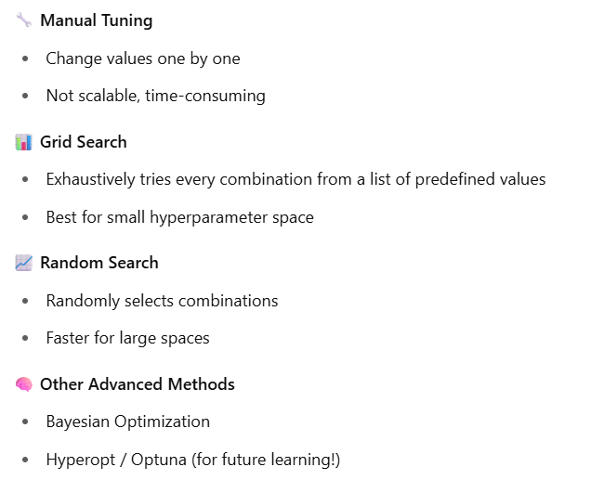
Techniques for Tuning
How to use random search and grid search in program

Slide 5
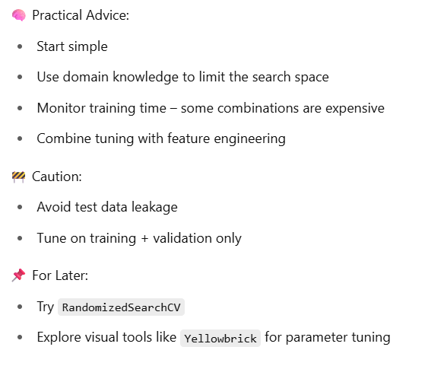
Best Practices

